Slide 1

SEA Programming Language
SER 502 – Emerging Languages and Programming Paradigms
https://github.com/amitmaharana/SER502-Spring2020-Team1

Slide 2
What is SEA?
Simple Everyday Arithmetic Programming Language

Slide 3
Why use SEA?
Easy to use
Fast to implement

Slide 4
Features Supported
Datatypes: Integer, Boolean, String
Data structure: Arrays (zero-indexed)
Operators: Arithmetic, Relational, Logical, Assignment
Conditional Constructs: if-else and ternary operator
Looping Structures: for, while, range
String Operations: length, concat, equals, split, substring
Array Operations: length, assign and access array elements by index

Slide 5
Contents
Grammar
Lexical Analyzer
Parser
Runtime
Installation
Sample

Slide 6

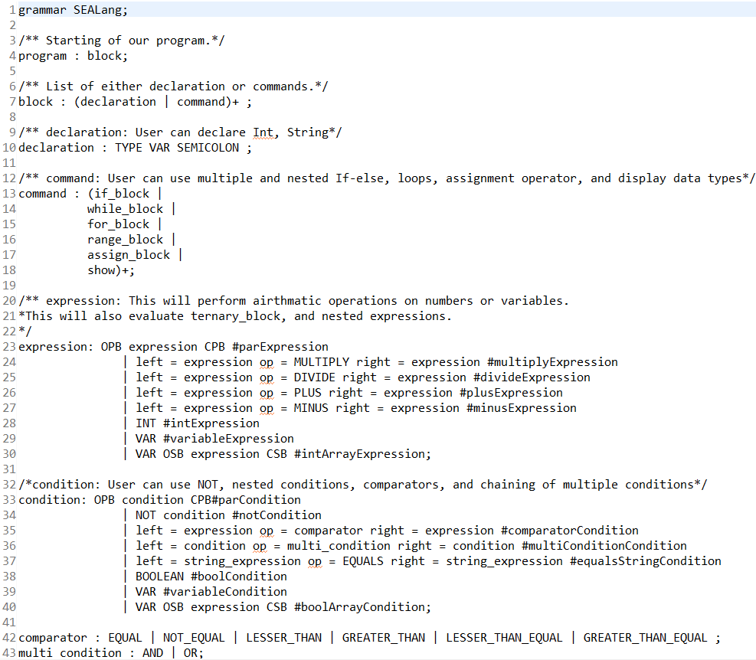
Grammar

Slide 7
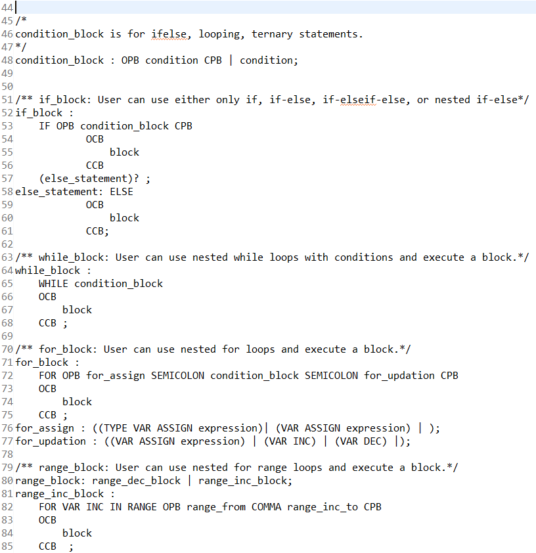
Grammar

Slide 8
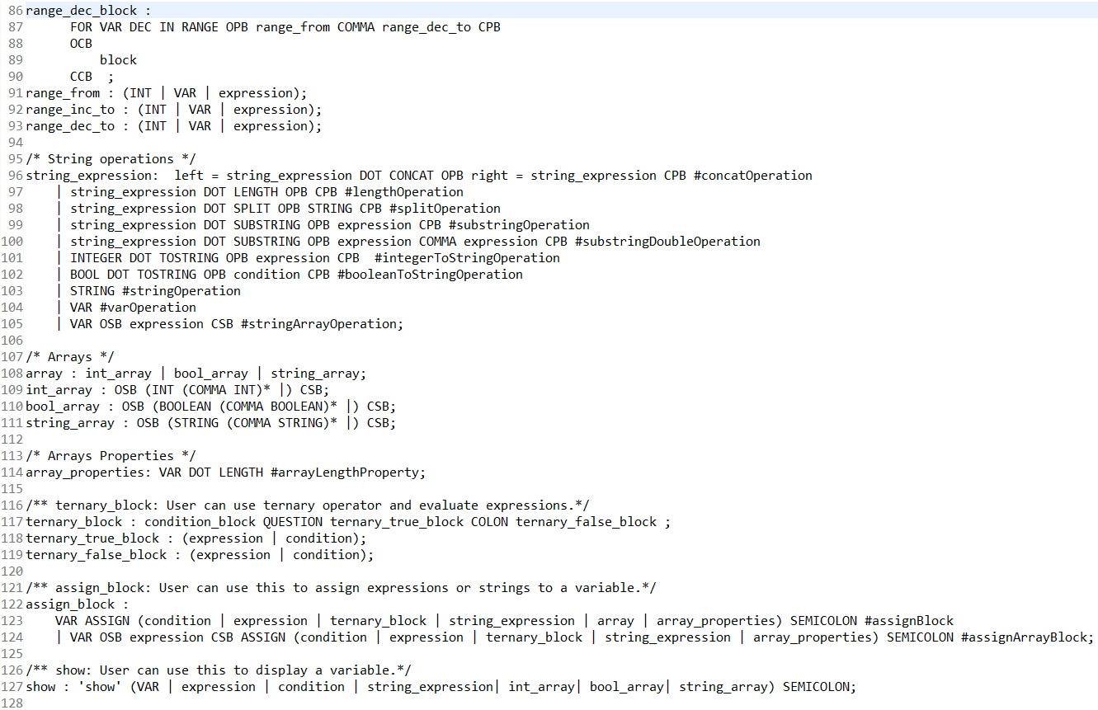
Grammar

Slide 9
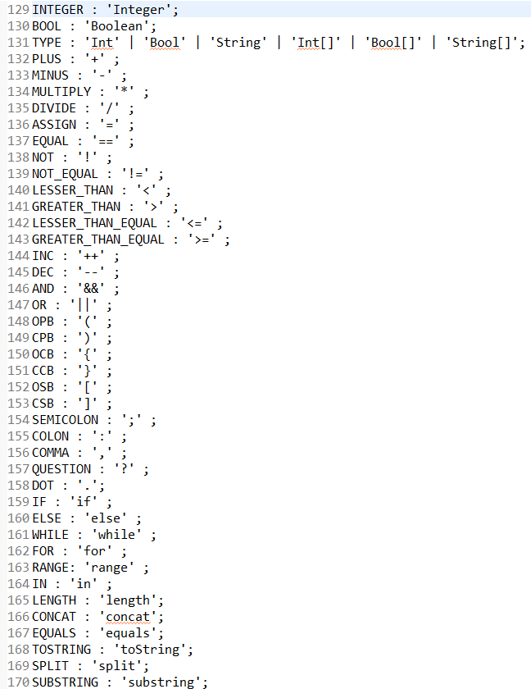
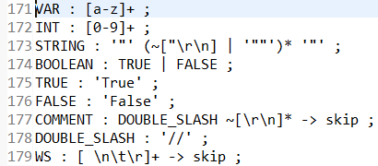
Grammar

Slide 10
Lexical Analyzer
Lexing or tokenization is provided by ANTLR, which takes the .sea file as input and generates tokens which is sent as input to the parser
Sample input
Int a;
a = (2 + 3) * 5;
show a;

Slide 11
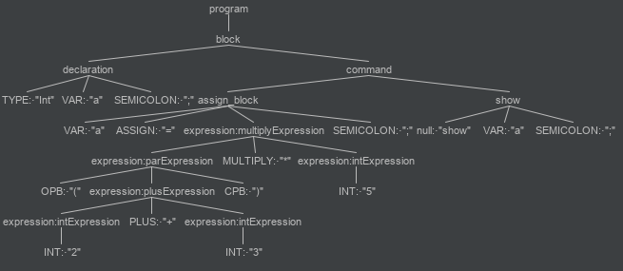
Parser
Parsing is also provided by ANTLR, it performs syntactic analysis on the tokens generated by the lexer and generates a parse tree

Slide 12
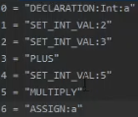
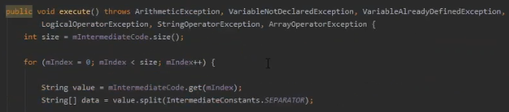
Runtime
Based on the parse tree, first the intermediate code stack is populated and then processed by the runtime

Slide 13

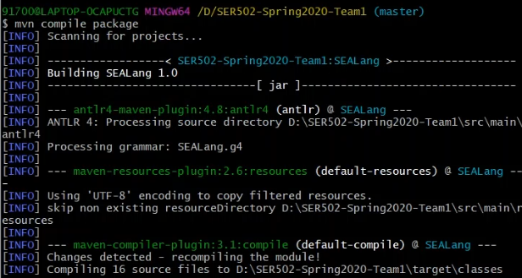
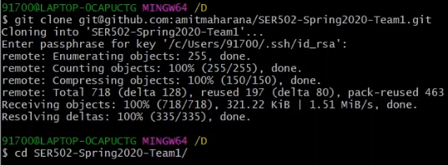
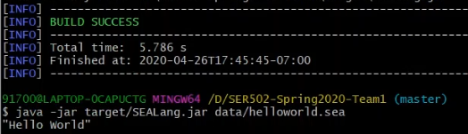
Installation
Step 1
Step 2
Step 3

Slide 14
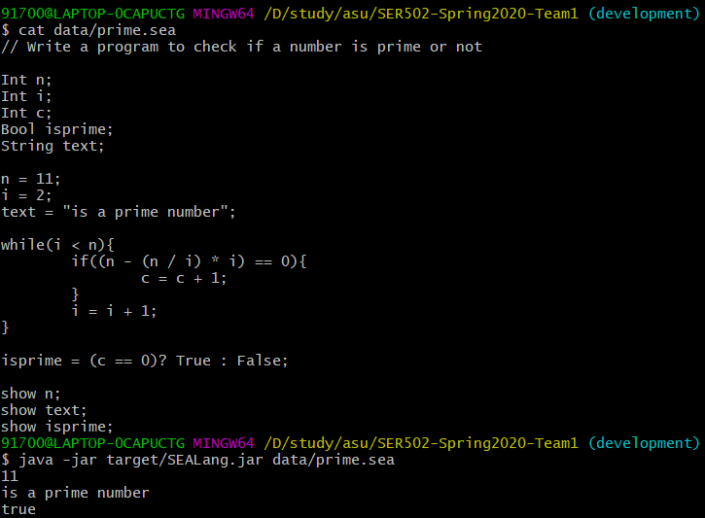
Sample Program

Slide 15
Thank You
Amit | Eric | Shubham | Shwetank
Team 1

